Slide 1
Normalization in DBMS

Slide 2
Anomalies in DBMS
In DBMS, anomaly means the inconsistency occurred in the relational table during the operations performed on the relational table.
There can be various reasons for anomalies to occur in the database.
For example, if there is a lot of redundant data present in our database then DBMS anomalies can occur.
If a table is constructed in a very poor manner then there is a chance of database anomaly.

Slide 3
Due to database anomalies, the integrity of the database suffers.
The other reason for the database anomalies is that all the data is stored in a single table.
So, to remove the anomalies of the database, normalization is the process which is done where the splitting of the table and joining of the table (different types of join) occurs.

Slide 4
Three types of an anomaly in the database
Update Anomaly
Insertion Anomaly
Deletion Anomaly

Slide 5
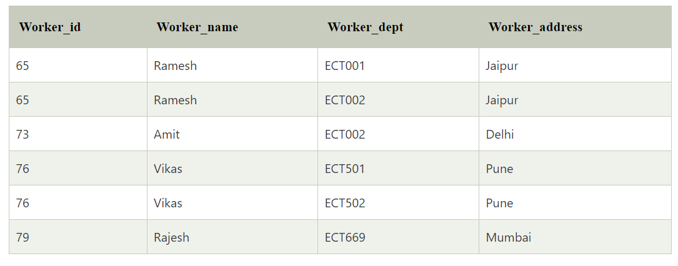
The above table is not normalized, and there is definitely a chance of anomalies present in the table.

Slide 6
Insertion Anomaly
If there is a new row inserted in the table and it creates the inconsistency in the table then it is called the insertion anomaly.
For example, if in the above table, we create a new row of a worker, and if it is not allocated to any department then we cannot insert it in the table so, it will create an insertion anomaly.

Slide 7
Deletion Anomaly
delete some rows from the table and if any other information or data which is required is also deleted from the database, this is called the deletion anomaly in the database.
For example, in the above table, if we want to delete the department number ECT669 then the details of Rajesh will also be deleted since Rajesh's details are dependent on the row of ECT669.
So, there will be deletion anomalies in the table.

Slide 8
Update Anomaly
When we update some rows in the table, and if it leads to the inconsistency of the table then this anomaly occurs.
This type of anomaly is known as an updation anomaly.
In the above table, if we want to update the address of Ramesh then we will have to update all the rows where Ramesh is present.
If during the update we miss any single row, then there will be two addresses of Ramesh, which will lead to inconsistent and wrong databases.

Slide 9
To remove this type of anomalies, normalize the table or split the table or join the tables.
There can be various normalized forms of a table like 1NF, 2NF, 3NF, BCNF etc.

Slide 10
Functional Dependency
The functional dependency is a relationship that exists between two attributes.
It typically exists between the primary key and non-key attribute within a table.
X → Y
The left side of FD is known as a determinant, the right side of the production is known as a dependent.

Slide 11
For example:
Assume we have an employee table with attributes: Emp_Id, Emp_Name, Emp_Address.
Here Emp_Id attribute can uniquely identify the Emp_Name attribute of employee table because if we know the Emp_Id, we can tell that employee name associated with it.
Functional dependency can be written as:
Emp_Id → Emp_Name
We can say that Emp_Name is functionally dependent on Emp_Id.

Slide 12
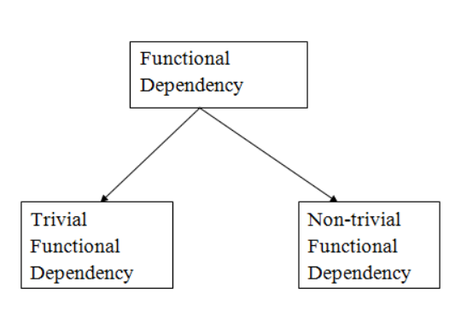
Types of Functional dependency

Slide 13
Trivial functional dependency
A → B has trivial functional dependency if B is a subset of A.
The following dependencies are also trivial like: A → A, B → B
Example:
Consider a table with two columns Employee_Id and Employee_Name.
{Employee_id, Employee_Name} → Employee_Id is a trivial functional dependency as
Employee_Id is a subset of {Employee_Id, Employee_Name}.
Also, Employee_Id → Employee_Id and
Employee_Name → Employee_Name are trivial dependencies too.

Slide 14
Non-trivial functional dependency
A → B has a non-trivial functional dependency if B is not a subset of A.
When A intersection B is NULL, then A → B is called as complete non-trivial.
Example:
ID → Name,
Name → DOB

Slide 15
Inference Rule (IR)
The Armstrong's axioms are the basic inference rule.
Armstrong's axioms are used to conclude functional dependencies on a relational database.
The inference rule is a type of assertion. It can apply to a set of FD(functional dependency) to derive other FD.
Using the inference rule, we can derive additional functional dependency from the initial set.

Slide 16
The Functional dependency has 6 types of inference rule:
1. Reflexive Rule (IR₁)
In the reflexive rule, if Y is a subset of X, then X determines Y.
If X ⊇ Y then X → Y
Example:
X = {a, b, c, d, e}
Y = {a, b, c}

Slide 17
2.Augmentation Rule (IR₂)
The augmentation is also called as a partial dependency. In augmentation, if X determines Y, then XZ determines YZ for any Z.
If X → Y then XZ → YZ
Example:
For R(ABCD), if A → B then AC → BC

Slide 18
3. Transitive Rule (IR₃)
In the transitive rule, if X determines Y and Y determine Z, then X must also determine Z.
If X → Y and Y → Z then X → Z
4. Union Rule (IR₄)
Union rule says, if X determines Y and X determines Z, then X must also determine Y and Z.
If X → Y and X → Z then X → YZ

Slide 19
5. Decomposition Rule (IR₅)
Decomposition rule is also known as project rule. It is the reverse of union rule.
This Rule says, if X determines Y and Z, then X determines Y and X determines Z separately.
If X → YZ then X → Y and X → Z

Slide 20
6. Pseudo transitive Rule (IR₆)
In Pseudo transitive Rule, if X determines Y and YZ determines W, then XZ determines W.
If X → Y and YZ → W then XZ → W

Slide 21
Union: If A→B holds and A→C holds, then A→BC holds. If X→Y and X→Z then X→YZ.
Composition: If A→B and X→Y hold, then AX→BY holds.

Slide 22
a)F = { A → B }
Using Augmentation, derive a new functional dependency.
Answer:
By Augmentation, we can add any attribute (say, C) to both sides:
A → B ⟹ AC → BC
b) F = { A → B, B → C }
Using Transitivity, what can you derive?
Answer:
From A → B and B → C, by Transitivity:
A → C

Slide 23
Given: F = { A → B, B → C, C → D }
Find the closure of A (A⁺).
Solution:
A → B
B → C
C → D
Thus, A⁺ = { A, B, C, D }
F = { AB → C, C → D }
Find if AB → D is valid using Armstrong's axioms.
Solution:
AB → C (given)
C → D (given)
Thus, by Transitivity:
AB → D

Slide 24
Example questions
F = { A → B, B → C }
Find the closure of A (i.e., A⁺).
Given F = { A → BC, B → D, C → E }
Find A⁺.
Given F = { A → B, C → D, D → E }
Find closure of AC.
Given F = { AB → C, C → D, D → E }
Find AB⁺.
Given F = { A → B, B → A, A → C }
Find A⁺ and B⁺.

Slide 25
Equivalence of Functional Dependencies
Let FD1 and FD2 be two FD sets for a relation R.
If all FDs of FD1 can be derived from FDs present in FD2, we can say that FD2 ⊃ FD1.
If all FDs of FD2 can be derived from FDs present in FD1, we can say that FD1 ⊃ FD2.
If 1 and 2 both are true, FD1=FD2.

Slide 26
Let us take an example to show the relationship between two FD sets. A relation R(A,B,C,D) having two FD sets
FD1 = {A->B, B->C, AB->D} and FD2 = {A->B, B->C, A->C, A->D}
Step 1: Checking whether all FDs of FD1 are present in FD2
A->B in set FD1 is present in set FD2.
B->C in set FD1 is also present in set FD2.
AB->D is present in set FD1 but not directly in FD2 but we will check whether we can derive it or not.
For set FD2, (AB)⁺ = {A, B, C, D}. It means that AB can functionally determine A, B, C, and D. So AB->D will also hold in set FD2.
As all FDs in set FD1 also hold in set FD2, FD2 ⊃ FD1 is true.

Slide 27
Step 2: Checking whether all FDs of FD2 are present in FD1
A->B in set FD2 is present in set FD1.
B->C in set FD2 is also present in set FD1.
A->C is present in FD2 but not directly in FD1 but we will check whether we can derive it or not.
For set FD1, (A)⁺ = {A, B, C, D}. It means that A can functionally determine A, B, C, and D. SO A->C will also hold in set FD1.
A->D is present in FD2 but not directly in FD1 but we will check whether we can derive it or not. For set FD1, (A)⁺ = {A, B, C, D}. It means that A can functionally determine A, B, C, and D. SO A->D will also hold in set FD1.
As all FDs in set FD2 also hold in set FD1, FD1 ⊃ FD2 is true.
Step 3: As FD2 ⊃ FD1 and FD1 ⊃ FD2 both are true FD2 =FD1 is true. These two FD sets are semantically equivalent.

Slide 28
Let us take another example to show the relationship between two FD sets. A relation R2(A,B,C,D) having two FD sets FD1 = {A->B, B->C,A->C} and FD2 = {A->B, B->C, A->D}

